Slide 1
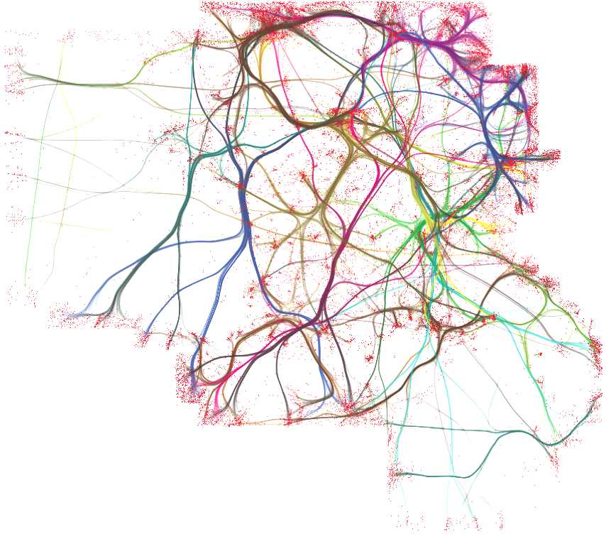


Danbury AI

Slide 2
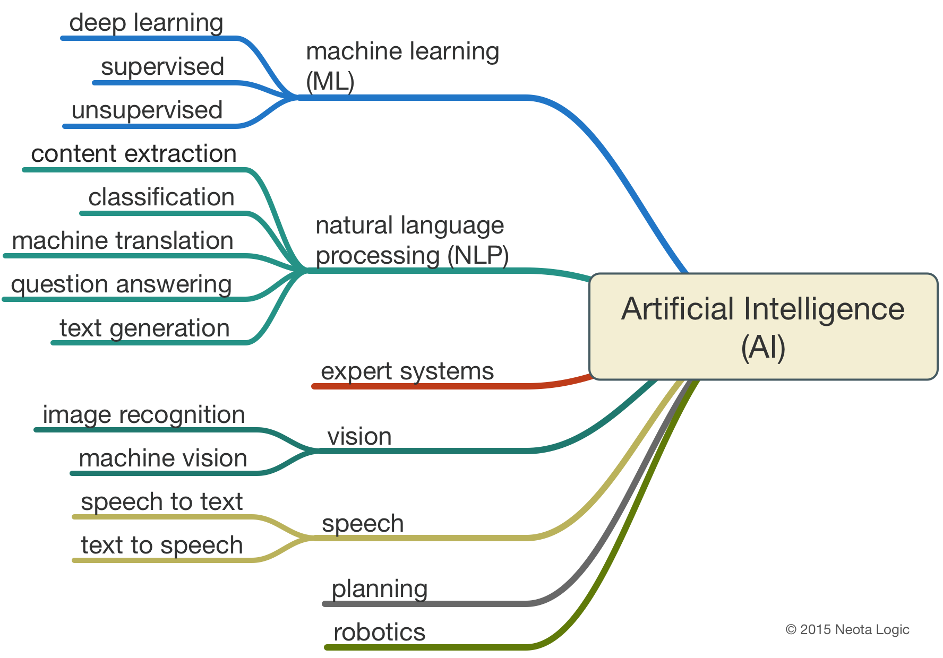
What do we mean by “AI”?
AI is an umbrella term for many different subfields which are grouped together by the concept of making programs that behave “intelligently.”
One way of looking at AI:

Slide 3
Meetup Goals
Bring people together around a common interest for mutual enrichment.
Share AI information, news, and opportunities.
Have monthly talks on interesting AI topics.
Develop a team for Kaggle,etc competitions.
Create a local hub for AI discussion, research, and collaboration.
Create a pool of computational resources for research.

Slide 4
Member Archetypes
We are a free meetup open to the public. The key feature we wish members to have is a passion for learning or mastering AI topics.
You can be:
A student.
An expert.
A novice.
Anyone!
We want to provide resources and systems that allow everyone to flourish!

Slide 5
Introductions
Let’s take a moment to get acquainted. Please tell us the following:
Your name
Education, Skill Background, or Profession
What drew you to the group? What about AI interests you?
What would you like to get out of an AI meetup?
Notes:
Introductions after we give them some context.

Slide 6
Meetup Structure
Monthly meetings with interesting talks.
We need speakers! Please let us know if you are interested in giving a talk!
First Tuesday of every month. Starts at 7pm.
Online Collaboration and Connection
Slack, Medium Publication, Meetup & Forums, Linkedin Group, Facebook Group.
News letter. ( possible )
Weekly aggregate of AI news and DanburyAI community communiqués.
Suggestions? Message us!

Slide 7
Key Links & Resources
Github: https://github.com/DanburyAI
LinkedIn Group: https://www.linkedin.com/groups/8537797
Facebook Group: https://www.facebook.com/DanburyAI/
Meetup: http://www.meetup.com/DanburyAI/
Medium Publication: https://medium.com/danbury-ai
Slack: Ask for an invite!

Slide 8
Our speaker:
Brian Griner, PhD
Quick Facts
Ph.D., Public Policy Research & Analysis from University of Pittsburgh.
Notes:
Mention that we hold questions till the end..

Slide 9
Using Bayesian Networks for Segmentation, Targeting & Position of New Products

Slide 10
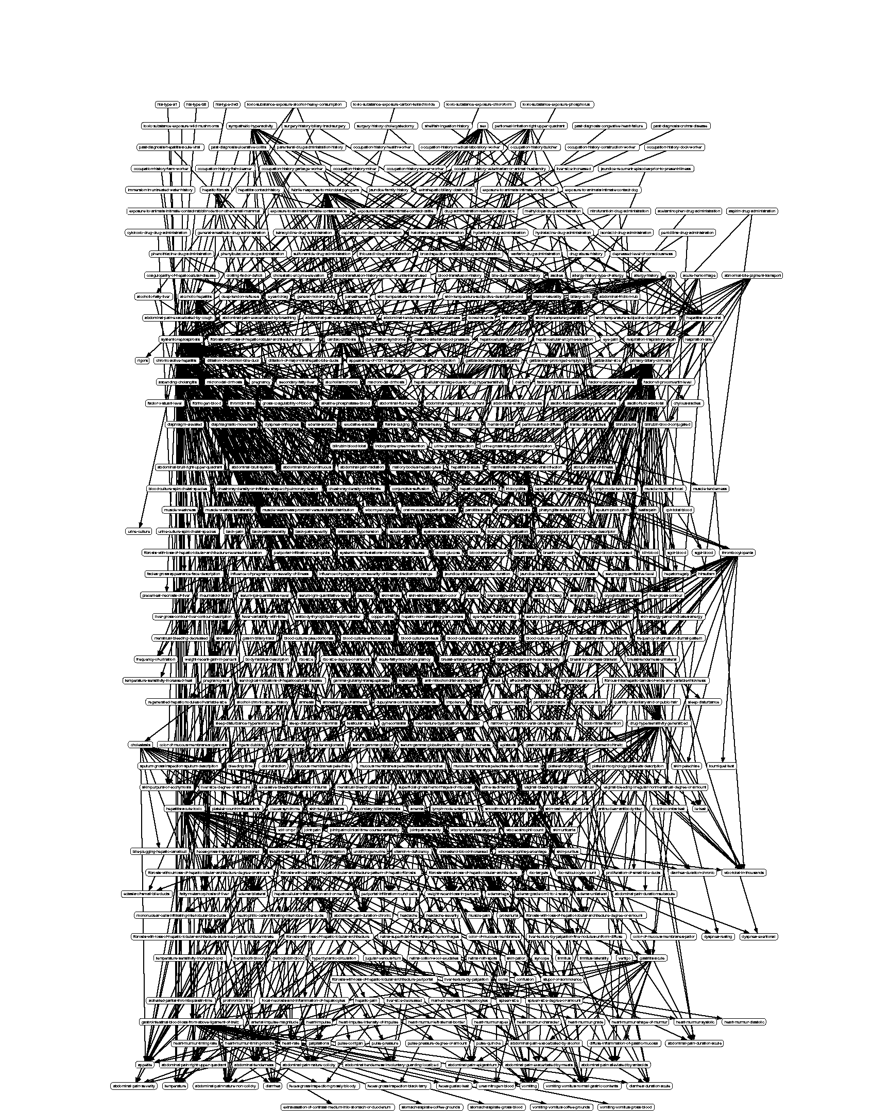
Bayesian Networks: Nothing to it, right?
The Computer-based Patient Case Study (CPCS) Bayesian Network* *(Pradhan et al. 1994) – 422 nodes: 14 disease, 33 history & risk, 375 health outcomes

Slide 11
A Definition
Bayesian Network [bey-zee-uhn net-wurk] 1. Informal: A series of interconnected models represented by a specific type of graph (i.e., a Directed Acyclical Graph or DAG)

Slide 12
Example of a Bayesian network with variables as “nodes” and relationships as “arcs”
Age
Specialty
Patient Characteristics
Physician Characteristics
Severity
Disease Activity
Attitude segment
Symptom 1
Symptom 2
Attitude 1
Attitude 2
Symptom 3
Attitude 3
Current Rx
Notes:
Nodes represent variables as distributions
Arcs represent relationships between variables

Slide 13
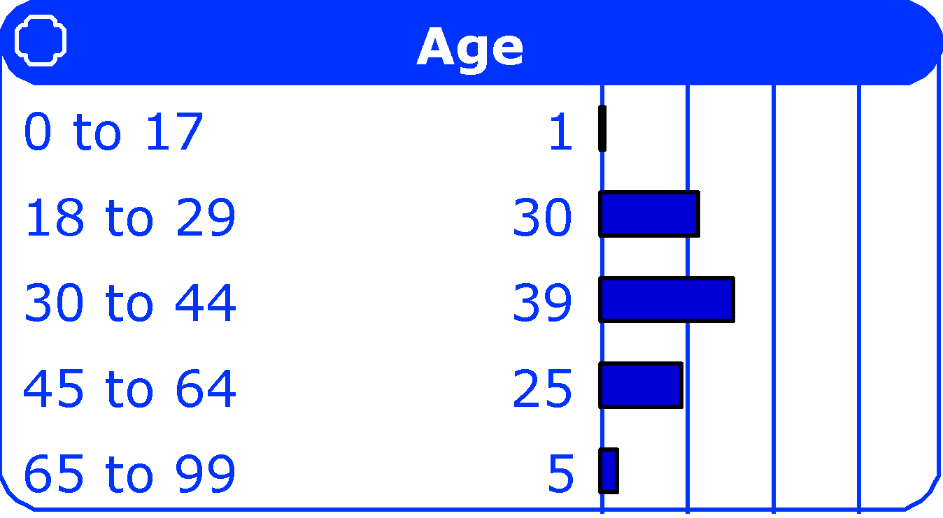
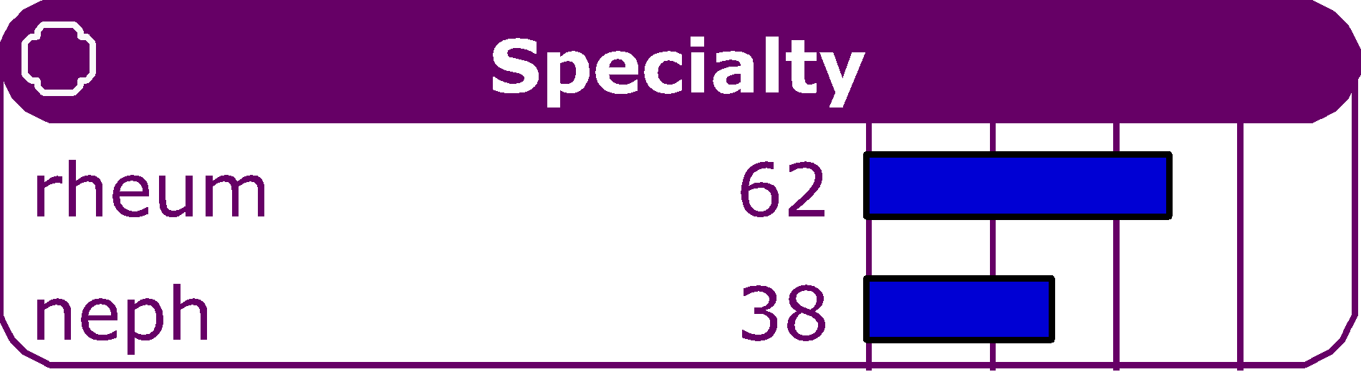
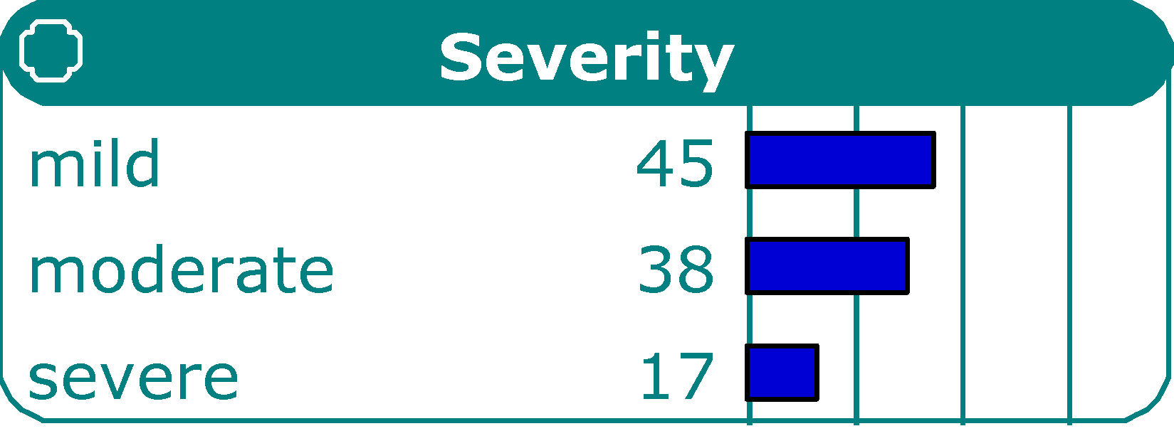
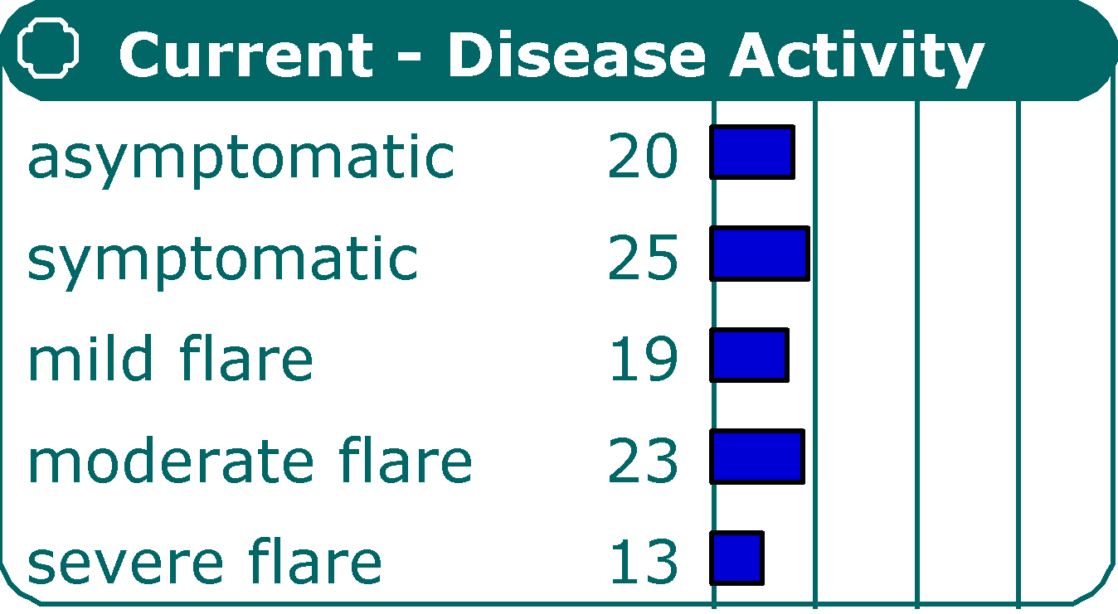
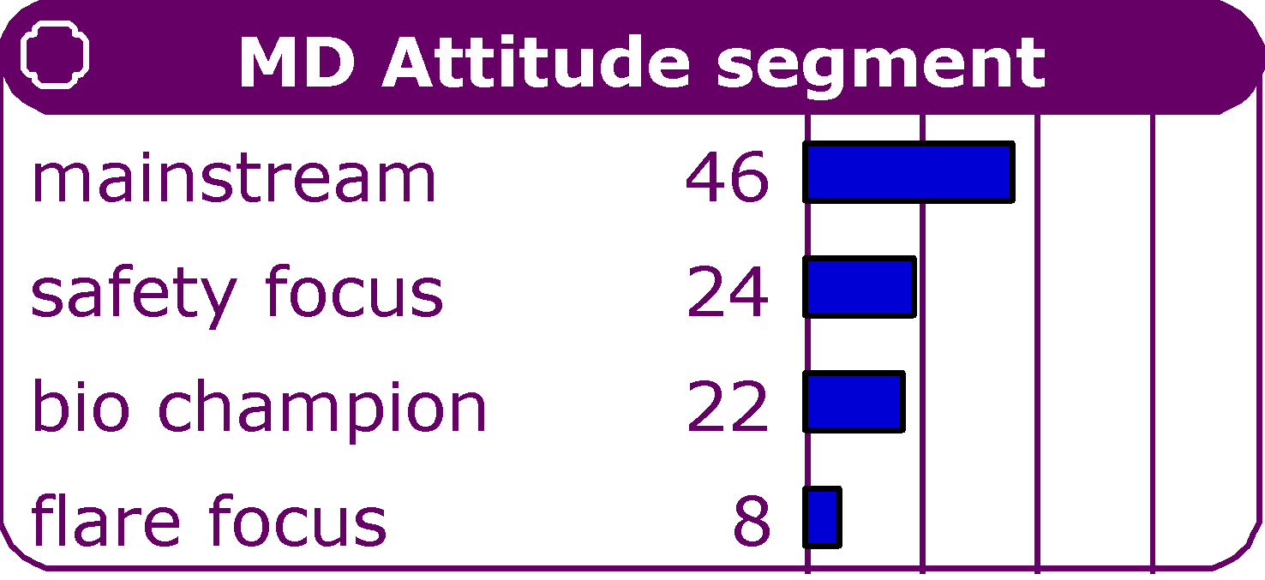
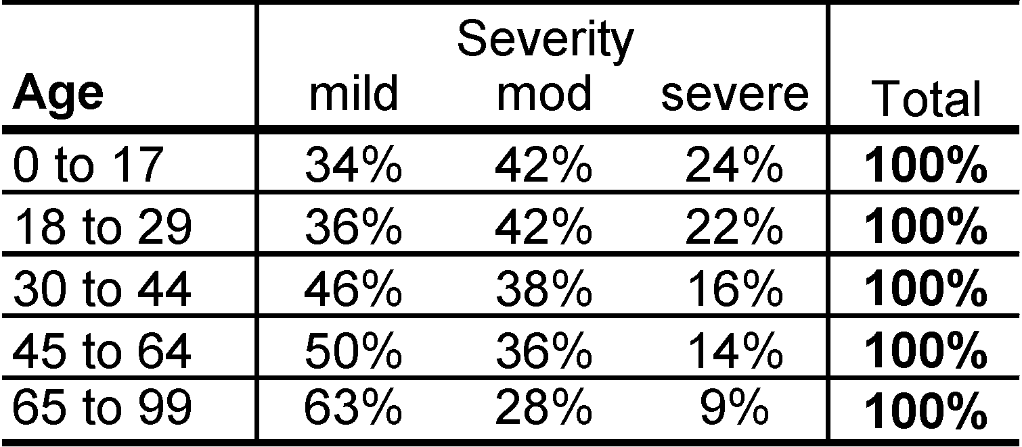
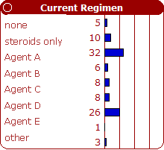
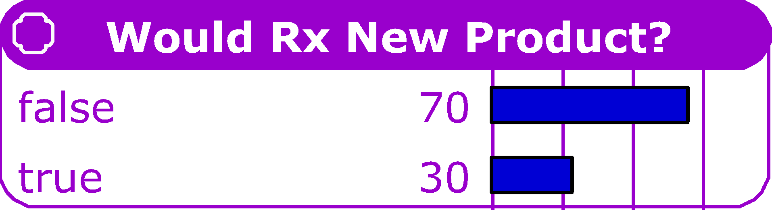
Behind each node is a conditional probability model linking the node to each of its ‘parent’ nodes
Notes:
There are multiple relationships being described here.
The distribution of a node (or variable) depends on the distribution of its “parent” nodes (i.e., the nodes that are connected to the target node by arcs)
Let’s pause for a minute and let me show you a very simple example of that relationship.

Slide 14
How a node in a Bayesian network operates
0
1
Parent Nodes (X₁,X₂)
X₁
X₂
(x₁,x₂)
1,1
1,0
0,1
0,0
0,1
0.7
lo
0.1
0.4
0.7
0.5
0.7
Child Node (Y)
Y
0.1
med
0.3
0.2
0.1
0.3
0.1
0.2
0.2
hi
0.6
0.4
0.2
0.2
Prediction (y | x₁,x₂)
lo : 0.7
med : 0.1
hi : 0.2
Notes:
Make just 3 main points here.
Conditional probability model is very similar to a regression model
We have a dependent variable (Child Node, Y) and independent variables (Parent Nodes, X₁ and X₂)
The predicted distribution of the Child Node depends on the distributions of the Parent Nodes

Slide 15
Comparison
 | Regression Model | Bayesian Network Model
Model Framework | One model | Series of models, linked as a system
Dependent, Independent Variables | One dependent variable linked to one or more independent variables | Every variable can be dependent or independent
Hypothesis Testing | Test relationships between each independent variable and the dependent variable | Test relationship between each variable and all other variables across the entire network
Prediction | Predicts average value of the dependent variable given the levels of each independent variable | Model based on joint probability of variables in the network Predicts the relationships of all the variables in a network simultaneously Predicts the entire joint distribution, not just one dependent variable
Notes:
Benefits:
Link individual models into a system
Measure uncertainty in the relationships between variables
X -> Y becomes prob(X) -> prob(Y|X)
Can easily incorporate beliefs and assumptions
E.g. connecting nodes with known causal relationships
Predict the change in one or more of the variables on the entire system

Slide 16
Case Study Simulating treatment flows and opportunity for newly launched asthma product
Business Situation
Business Need
Approach
New drug
Challenging profile
Crowded market
Treatment flow
Stakeholder segmentation
Market sizing
Promotional strategy
Multiple data inputs
EMR, Primary Research and Publications
Weighted segment sizes and treatment flows to the population
Bayesian network model provided an intuitive graphical model that:
Simulated treatment decisions across physician and patient types
Identified targeted patient and physician segmentation
Sized the market opportunity
Provided promotional material guidance
Notes:
Need:
A new drug launched is a crowded market (asthma)
Concern with side effects (steroids stunt growth in children)
Client needed to identify patient and physician segments of early adopters for targeted promotions
Approach:
Data inputs: EMR, primary case-based research and published research
Model: Bayesian network model created using conditional distributions from EMR and primary research.
Weights: Published research and secondary data used to create weights to project sizes of patient and physician segments and treatment flows to the population
Results:
Bayesian network model used to identify early adopter patient and physician segments
Weighted model used to size the market opportunity and target key physician segments with patient promotional materials

Slide 17
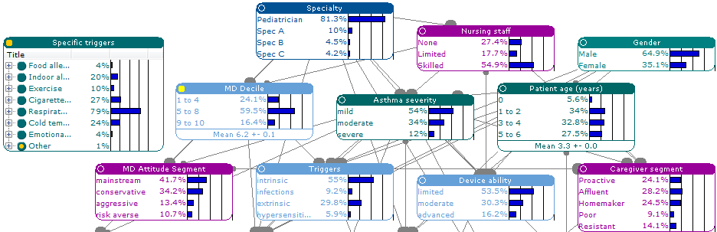
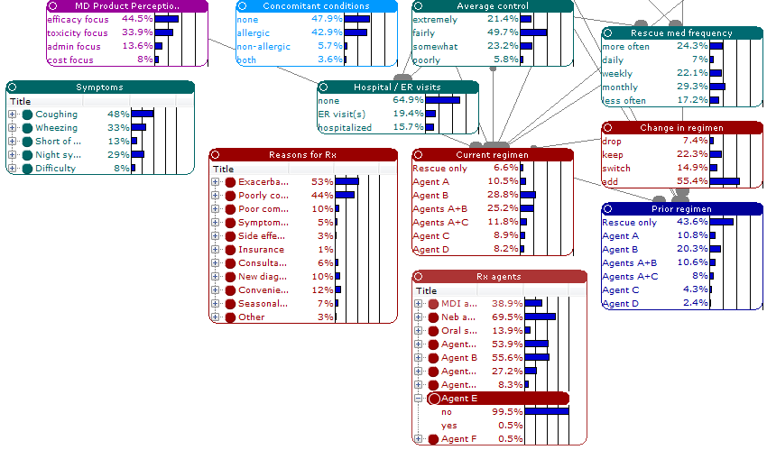
Bayesian Network Case Study
New product launch in crowded Asthma market
Bayesian Network of Asthma Patient Treatment Flow

Slide 18
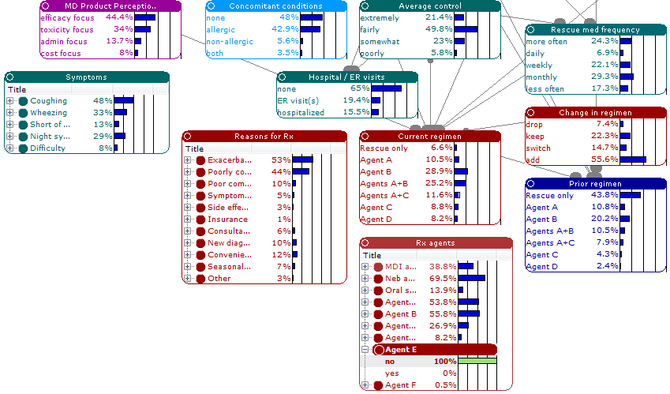
Select baseline for comparison
Step 1: Select all patients that were NOT candidates for the new therapy

Slide 19
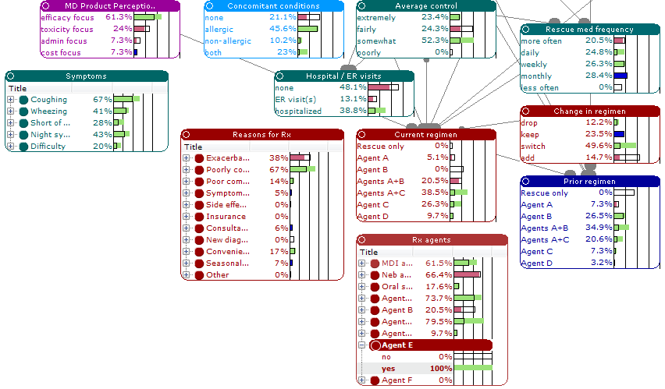
Select target patient type for new therapy
Step 2: Select all patients that were candidates for new therapy
Step 3: Identify patient and physician characteristics of target segments

Slide 20
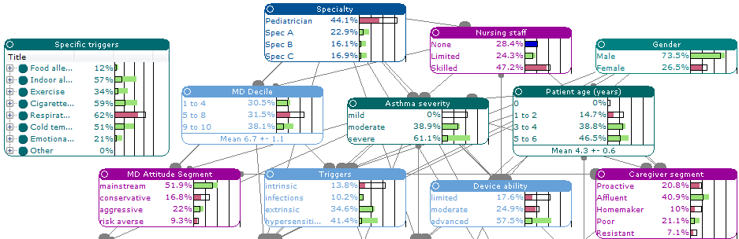
More characteristics of target segments
Segment profiles provide rich customer portraits of the target physicians and the patients who would be early adopters of the new therapy

Slide 21
In Conclusion
Bayesian Networks provide a simple way to link individual models into a system of cause and effect relationships
BNs can predict the impact of a change in one or more variables on ALL variables across the network
BNs are useful tools for simulating market dynamics (e.g., buying process) and identifying joint physician and patient segments for targeted promotions

